Slide 1
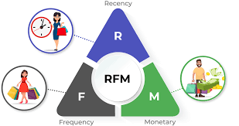
RFM Analysis
The “RFM” in RFM analysis stands for recency, frequency, and monetary value.
Recency: How recently has a customer made a purchase?
Frequency: How often do customers make a purchase?
Monetary Value: How much money a customer spends on purchases?
Basically RFM analysis allows marketers to target specific clusters of customers with communications that are much more relevant for their particular behavior – and thus generate much higher rates of response, plus increased loyalty and customer lifetime value to grow business in a positive direction.

Slide 2
Steps followed to Calculate RFM Score
First cleaning data i.e removing unwanted or blank customer ids. Just by filtering and deleting rows.
Then calculating total price for customer ids by simply using multiply function for qty and unit price. Here some qty are negative so we simply use abs()function to remove –ve sign as qty should never be negative.
Then we can pivote table in that in row we will select cust.id and in values will take countunique of invoce no. which give count of unique invoice no. Also Sum of total price and Max of Invoice date in values for each unique cust.id.
Here Sum of total price is Monetary and Countunique of invoice no is nothing but Frequency.
We will calculate Frequency just by subtracting todays date and Max of invoice date. Here we will use DATEDIF function to calculate it in days.
So now we have Recency, Frequency and Monetary. So we will assign rating 1 to 5 as per score. Before that we will calculate 5 Factor Values i.e Max,Min, 25^{th ,}75th and 50th Percentiles to assign rating as per Range.
For Recency lowest the score max will be rating to we will assign from 5 to1.
So as per 5 value we are going to provide rating and this should be in separate table for all Recency, Frequency and Monetary
accordingly.
Now we will use Vlookup to main data For Recency will calculate “R Score”, For Frequency will Calculate “F Score” and For Monetary will calculate “M Score”.
We will join these R , F and M Score by Concanate function to Get final RFM score and will assign category as per it by v Lookup function.

Slide 3
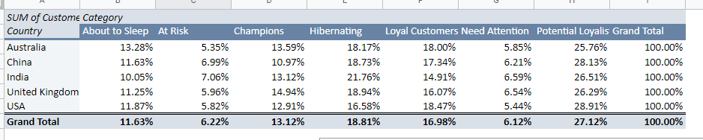
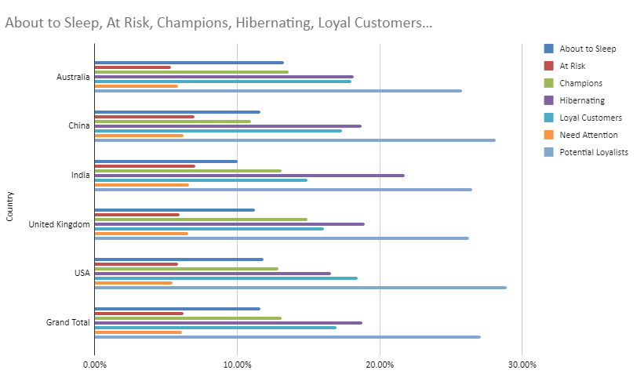
Customer segmentation Analysis
Here on percentage basis we can conclude that around 6% of people in each country need attention other they can go in abt to sleep mode. We have to contact them rigorously via mail, call and different offers.
On Graph showing that percentage wise distribution of category for each country by stack bar chart.
Here we can conclude that we have most champions i.e .around 15% in united kingdom and least i.e around 11% in China.
Also Most hibernating customers are in India i.e around 22% where we have to contact those by calls and provide max offers and discounts.
Also We should provide Nice membership packages to Potential Loyalist to become champions as to increase their recency score. In USA it is max. i.e 29%

Slide 4
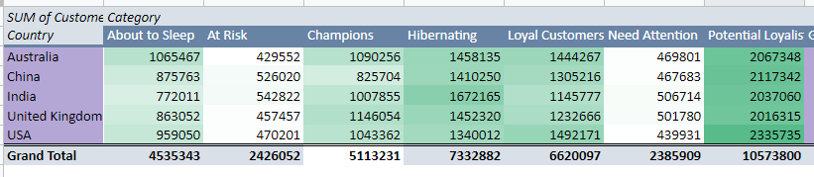
Heat map Analysis
In above pivot table we have provided color shaded by conditional formatting as per value. So here Max value is having Dark green colour followed by light shade and comparatively small values is almost while.
It is also called heat map.
Heat Maps are graphical representations of data that utilize color-coded systems. The primary purpose of Heat Maps is to better visualize the volume of customer/events within a dataset and assist in directing viewers towards areas on data visualizations that matter most.
Here we can conclude that the USA is having max number i.e 2335735 for potentially loyal and Australia is having very less customer i.e 429552 which are at risk.

Slide 5
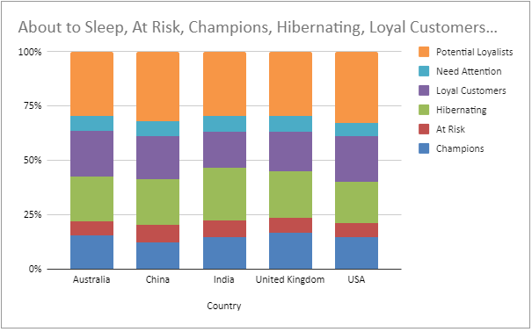
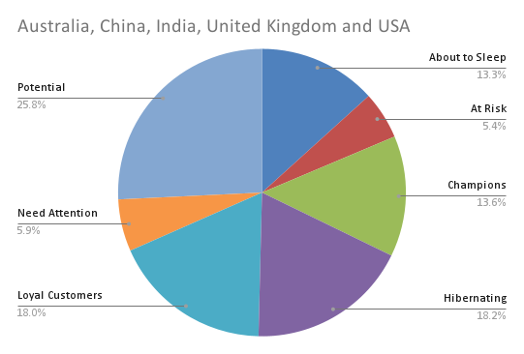
Geo chart with mark and Staked bar chart Analysis
PI Chart with Mark is showing just category which is highlighting on pi. Most values for category represents bigger spot on particular region and accordingly smaller dot represents less number for particular category in that respective region
Also stack bar chart we can conclude that Contribution of each category with respect to total for each country.
So here we can say that in chine at risk percentage is quite more than other countries. Also Loyal customers and potential to become a loyal customer are more in USA . We can increase potential loyal to loyal by providing good offers.

Slide 6
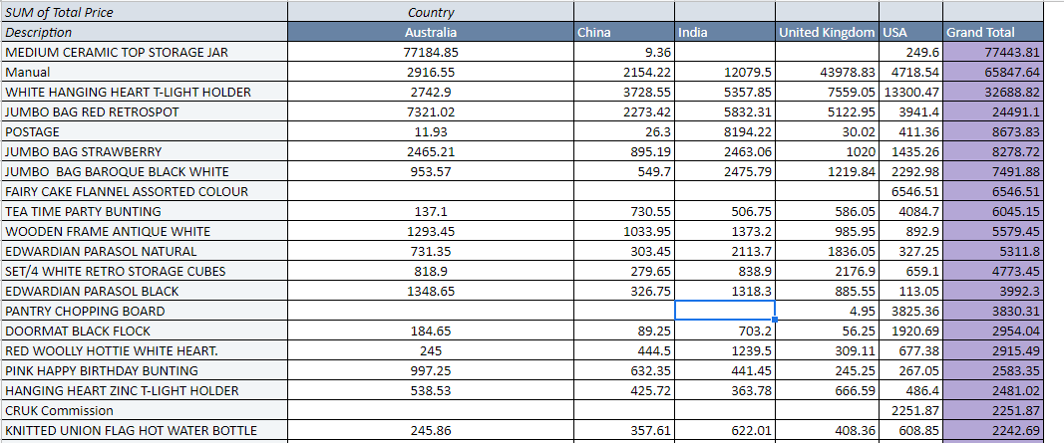
Product wise analysis Analysis
Above analysis shows Top 20 Product Description which are contributing Max selling price to business.
In this “Medium Ceramic top storage jar” is alone making 77443.81 money total and out of which 77184.85 money is coming only from Australia. So on other countries we should provide Max discount and offer on this product code. Also we should concentrate more manufacturing in Australia with high quality.
Same For Manual we have to provide more qty in UK and more discounts in other region.
Also products which are contributing less we should focus more on their quality and we should take feedbacks about those to increase their sell.

